Slide 1
Deployment of Kubernetes

Slide 2
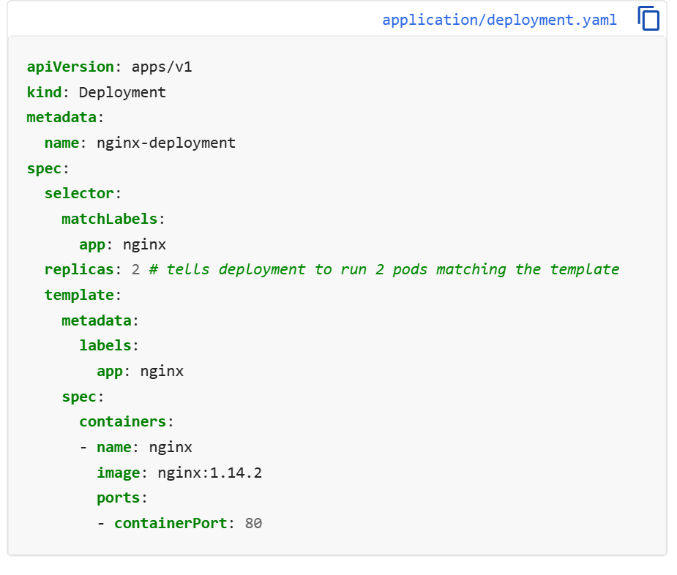
Steps:-
nano nginx.yaml
Link for nginx deployment yaml (https://kubernetes.io/docs/tasks/run-application/run-stateless-application-deployment/)

Slide 3
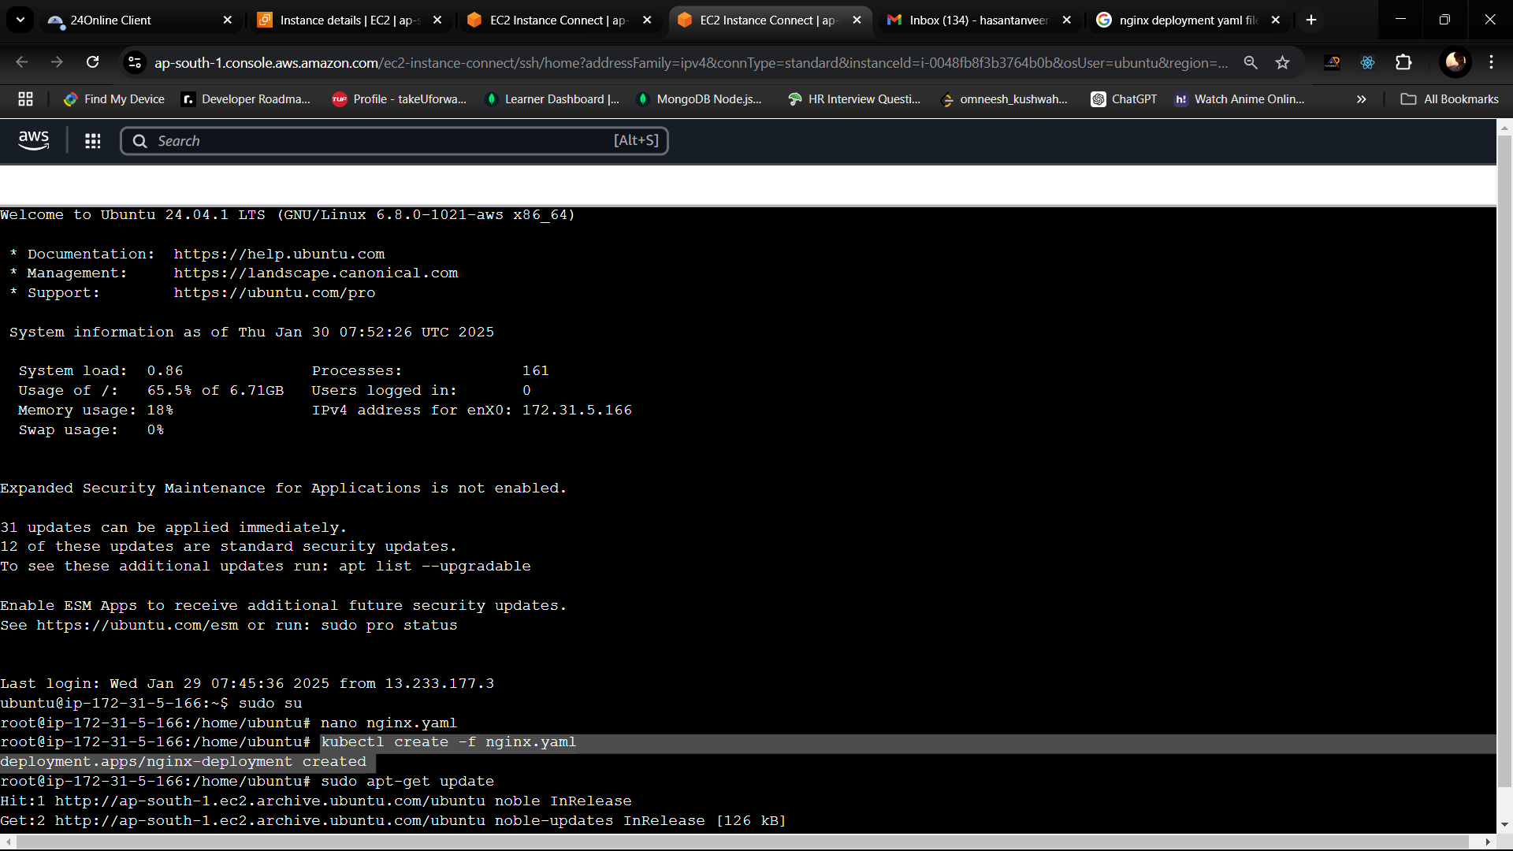
2. kubectl create -f nginx.yaml
3. Sudo apt-get update

Slide 4
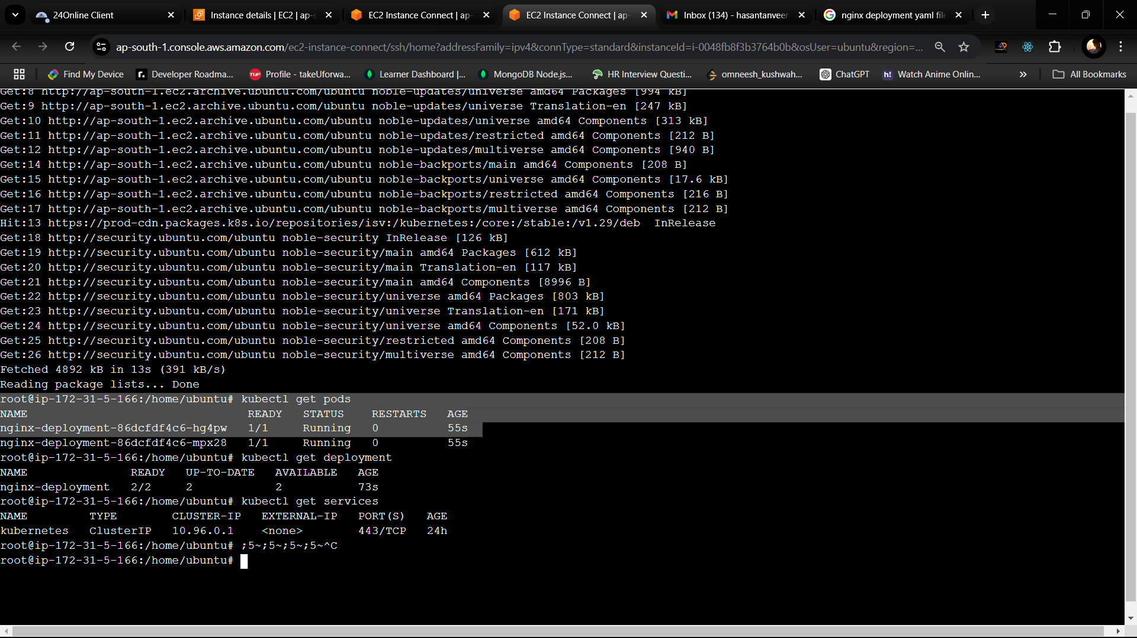
4. kubectl get pods

Slide 5
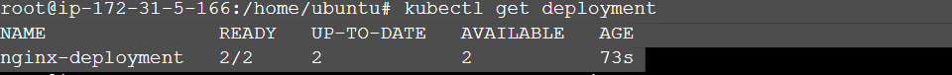
5. kubectl get deployment

Slide 6
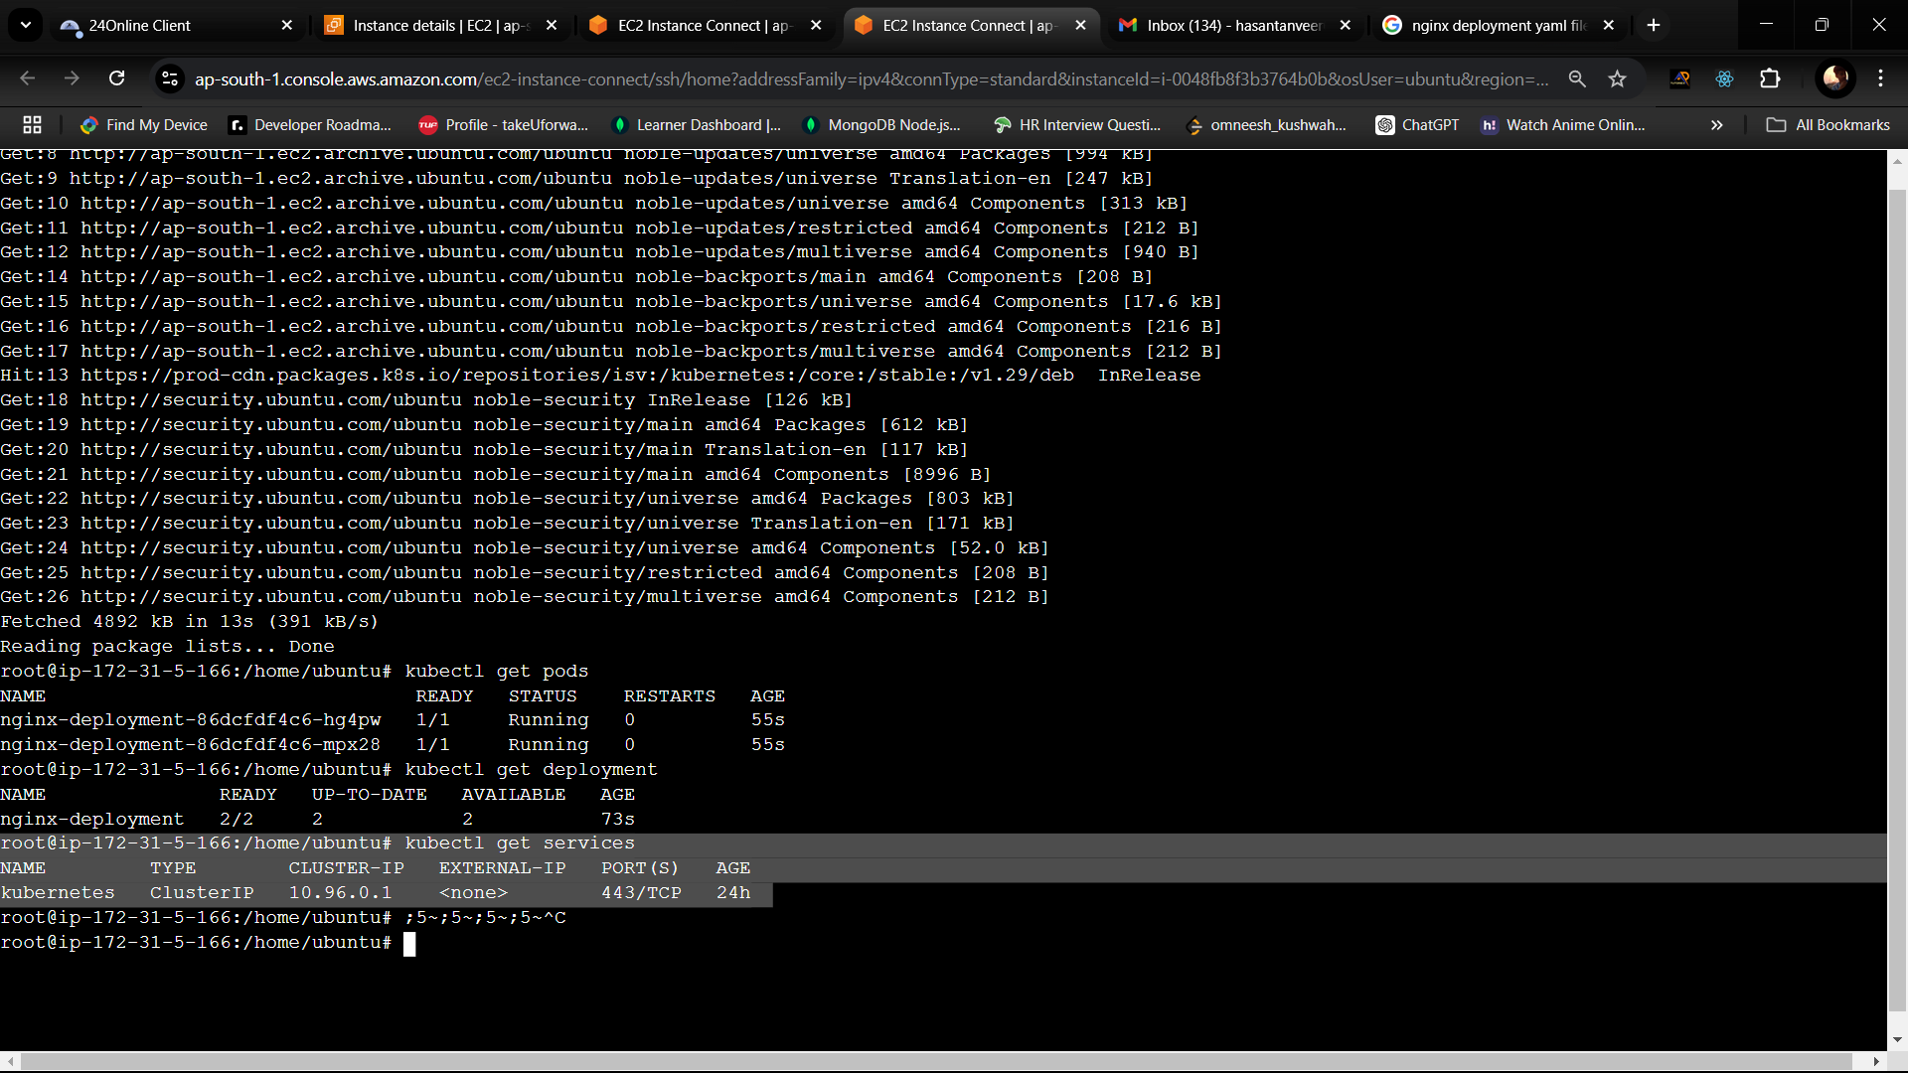
6. kubectl get services

Slide 7
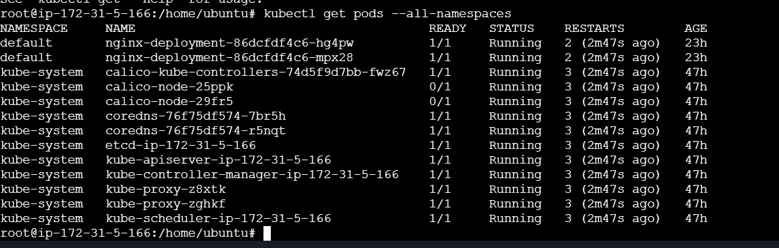
7. Kubectl get pods --all-namespaces

Slide 8
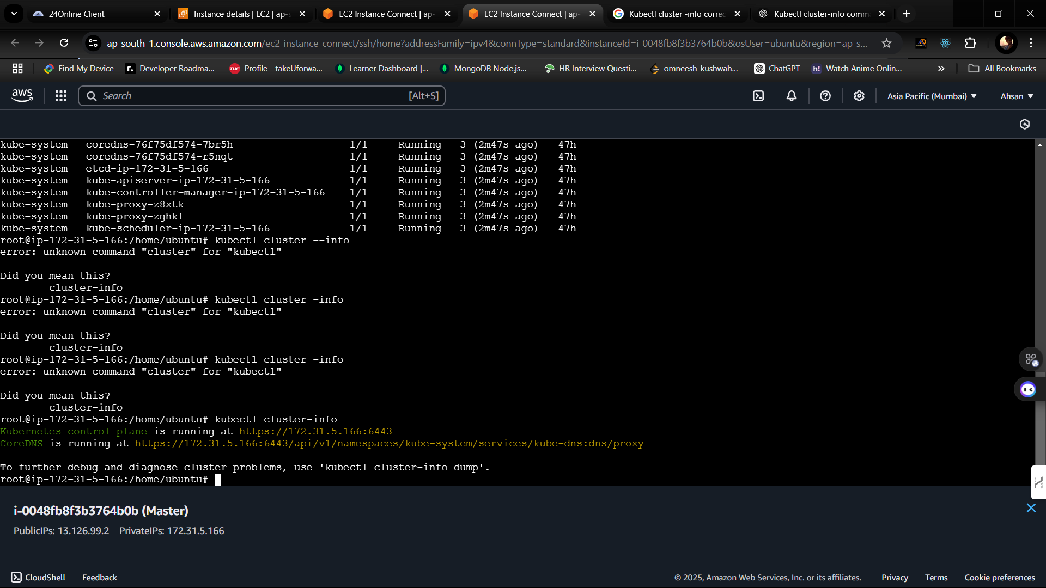
8. Kubectl cluster-info

Slide 9
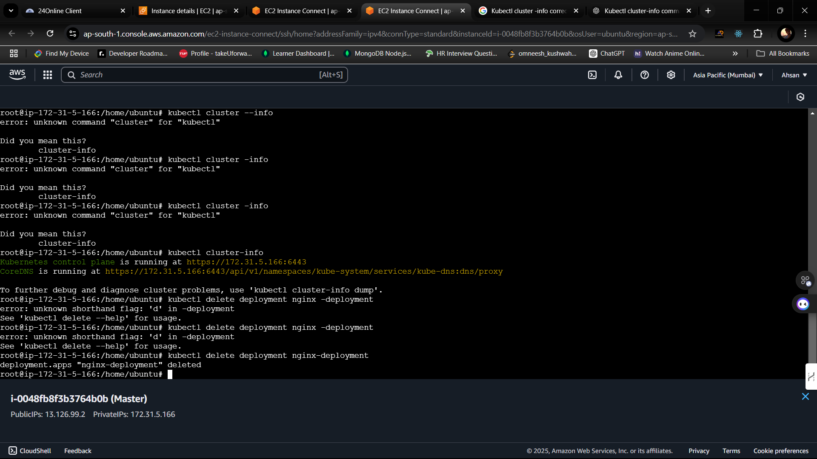
9. Kubectl delete deployment nginx-deployment

